Slide 1

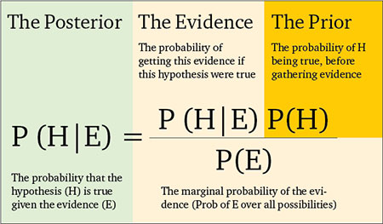
The case for Bayesian methods in benefit-risk assessment: Overview and future directions
19 May 2016 / Carl Di Casoli (Bayer) / Maria Costa (GSK, UK) / Weili He (Merck, Sharp, and Dohme) / Yueqin Zhao (FDA / CDER) / Yannis Jemiai (Cytel), Akos Ferenc Pap (Bayer) / Michael Crane
1

Slide 2
Presentation Outline
Background and Motivation
The Usefulness of Bayesian Inference
Top-Level Summary of Methods
Discussion of Three Recent Approaches
Conclusion: Future Research Directions in Bayesian Benefit-Risk
2

Slide 3
Background & Motivation
Assessing whether a drug works or not typically means to reach a statistically significant result for the comparison of interest which is usually efficacy only.
Reason: a B-R analysis can be also conducted to provide CI (CrI) and p-value
But how does one determine whether the Benefit-Risk (BR) profile of a drug is “positive”?
In recent years, qualitative frameworks and quantitative evaluations of BR have been proposed to support this challenging process.
DIA Bayesian Benefit Risk Working Group was formed, consisting of the
authors of this presentation.
3

Slide 4
Background and Motivation
One important aspect of any BR assessment is the inclusion of different stakeholders in the decision-making process.
In particular, there is growing recognition of the importance regarding endpoint selection and the weighting of different outcomes.
Levitan et al. (2014) looked at results of experiment where the patients’ weighting of the different benefits and risks differed substantially from those selected by regulators and sponsors.
The 21st Century Cures Act (21st Century Cures Act, 2015) further stresses the importance of including “patient experience data” in regulatory decision-making regarding the BR of a new medicinal product
Using quantitative BR techniques makes this assessment transparent, explicit and robust: which data is used and why, how different sources of data are integrated and how conclusions are derived.
4

Slide 5
The Usefulness of Bayesian Inference
Bayesian analysis, with its formal utilization of prior information and repeated updates, naturally supports decision theory.
Bayesian benefit-risk (BR) approaches allow one to explore the variability of the BR profile in the presence of uncertainty in a sequential manner as information accrues.
Decision-making under uncertainty is described in the FDA and EMA Benefit-Risk guidance documents as one of the key challenges of BR evaluations (FDA PDUFA V, 2013; EMA Benefit-risk methodology project).
When uncertainty results from lack of information (for example, lack of safety data due to insufficient exposure), regulatory agencies often rely on post-market data.
In this scenario, EMA’s Benefit-risk methodology project sees quantitative BR methods playing a key role in periodic benefit-risk evaluations.
5

Slide 6
The Usefulness of Bayesian inference
  The Bayesian updating mechanism based on accumulated data allows for the incorporation of external data and/or subjective beliefs, expert knowledge or patient insight.
  This formal inclusion of perspectives from different stakeholders can highlight potential divergences and lead to a more focused dialogue.
  The Bayesian framework, with its underlying prediction mechanism, also provides a natural approach for accounting for missing efficacy and safety data.
6

Slide 7
Top-Level Summary of Methods
Bayesian framework for sequential dose selection; e.g., optimize a utility function that describes the trade-off between efficacy and toxicity.
Braun (2002) provided the Continual Reassessment Method (bCRM): a Bayesian bivariate trial design in which the MTD is based on both toxicity and disease progression. Prior distributions are both relatively informative to offer direction to dose assignment when only a few subjects are present, but vague enough so that their influence decreases as more subjects are enrolled.
By contrast, maximum-likelihood based methods require that at least one subject experiences each of the possible combinations of the two binary outcomes before inferences can be made.
Thall and Cook (2004) extend Braun (2002) by:
  1. Providing an algorithm for eliciting subjective prior distributions based on expert judgment.
  2. Exploring the trade-off between the probability of the binary events toxicity and efficacy more fully using efficacy-toxicity trade-off contours rather than fixed target thresholds.
7

Slide 8
Top-Level Summary of Methods
Graham et al. (2001) develop a nonlinear Bayesian hierarchical model combined with utility functions to provide a framework for decision-making using both efficacy and safety data collected at the end of a dose-response trial.
Provides a natural framework for predicting the utility of specific dosing regimens for a new individual.
Sutton et al. (2005) extend the ideas of Bayesian BR assessment to a post-marketing/phase IV setting when other sources of evidence in addition to randomised controlled trials (RCT) may be available.
  Develop a net clinical benefit (NCB) model to assess the BR profile of a new medicine or intervention and use Bayesian inference to propagate uncertainty and derive posterior probabilities of desired, trial-specific outcomes
8

Slide 9
Bayesian Joint Modeling (Safety/Efficacy)
He et al. (2012) examined a Bayesian joint modelling and joint evaluation framework for incorporating both efficacy and safety data.
The joint model accounts for the intricate relationship between efficacy and safety data at the subject-level.
Estimates the posterior distributions of the efficacy and safety effects via Bayesian methods
Takes into consideration uncertainty of the true efficacy and safety effects; provides a more objective assessment of the BR trade-off.
He et al. (2016) extend this work to multiple efficacy and safety outcomes.
See also Gould et al. (2014) for a literature review on further Bayesian approaches to joint modeling of survival and longitudinal data.
9

Slide 10
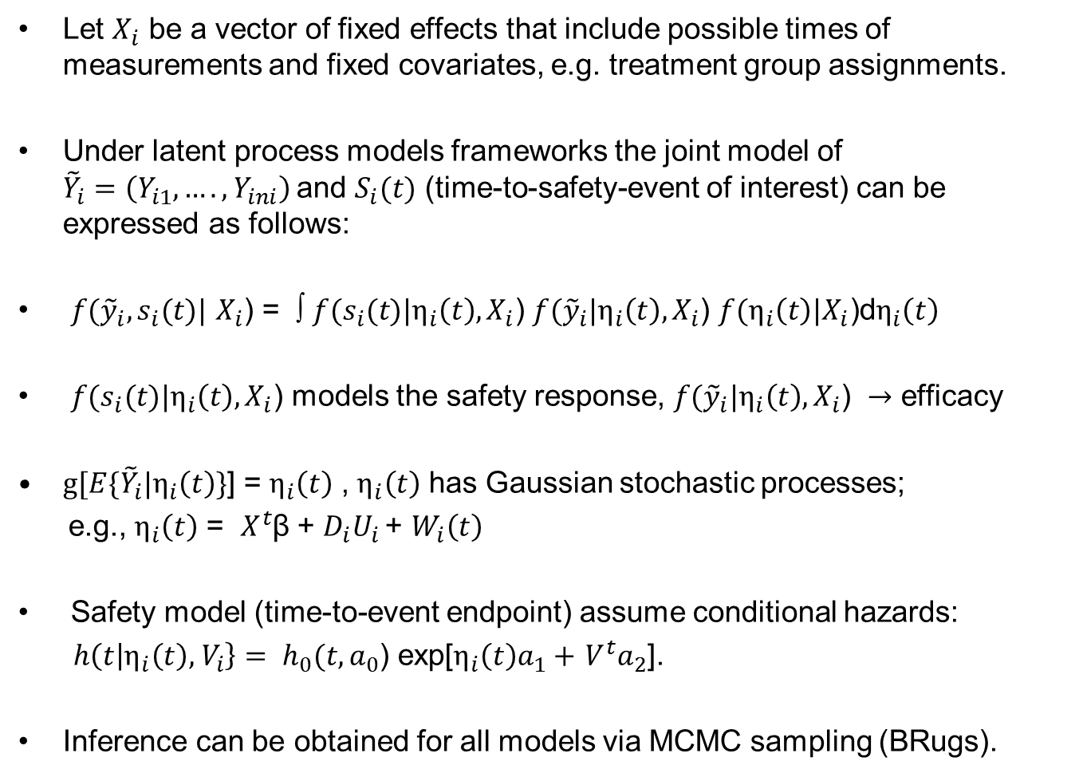
Bayesian Joint Modeling Model Details
Let $X_{i}$ be a vector of fixed effects that include possible times of measurements and fixed covariates, e.g. treatment group assignments.
Under latent process models frameworks the joint model of ${\tilde{Y}}_{i}=\left(Y_{i1},….,Y_{ini}\right)$and $S_{i}(t)$ (time-to-safety-event of interest) can be expressed as follows:
$f({\tilde{y}}_{i},s_{i}(t)|$ $X_{i}$) = ∫ $f(s_{i}(t)|η_{i}\left(t\right),X_{i}\text{)}$ $f({\tilde{y}}_{i}|η_{i}\left(t\right),X_{i}\text{)}$ $f(η_{i}\left(t\right)|X_{i}\text{)}\text{d}η_{i}\left(t\right)$
$f(s_{i}(t)|η_{i}\left(t\right),X_{i}\text{)}$ models the safety response, $f({\tilde{y}}_{i}|η_{i}\left(t\right),X_{i}\text{)} →$ efficacy
$g[E\{{\tilde{Y}}_{i}|η_{i}\left(t\right)\}$] = $η_{i}\left(t\right)$ , $η_{i}\left(t\right)$ has Gaussian stochastic processes;
e.g., $η_{i}\left(t\right)$ = $X^{t}$β + $D_{i}U_{i }$+ $W_{i}\left(t\right)$
Safety model (time-to-event endpoint) assume conditional hazards:
$h\left(t | η_{i}\left(t\right),{ V}_{i}\right\}= h_{0}(t, a_{0}$) exp[$η_{i}\left(t\right)a_{1}+$ $V^{t}a_{2}$].
Inference can be obtained for all models via MCMC sampling (BRugs).
10

Slide 11
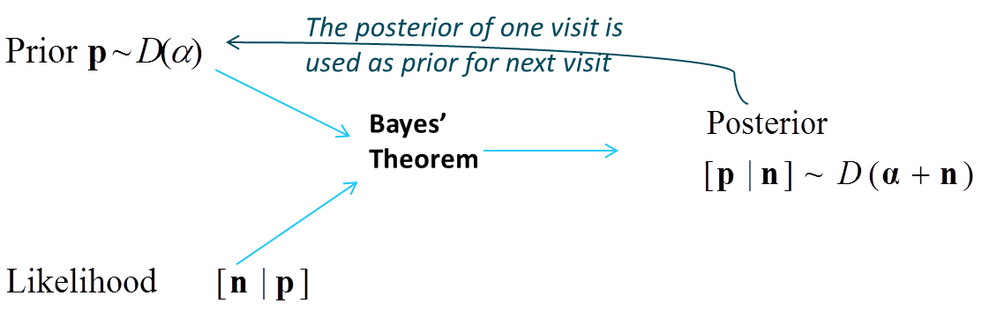
Bayesian Approach to Model Benefit-Risk
For a longitudinal BR assessment of the treatment effect, Zhao et al. (2014) propose a Bayesian model to sequentially update information accrued across visits based on Chuang-Stein’s BR categories and measures (Chuang-Stein et al., 1991).
It assumes that the subject-level outcomes of a clinical trial can be classified into five mutually exclusive categories which is derived at each visit using sequentially updated posterior as a prior.
1. benefit without adverse effect, 2. benefit with adverse effect, 3. no benefit with no adverse effect, 4. no benefit but with adverse effect, 5. and withdrawal.
11

Slide 12
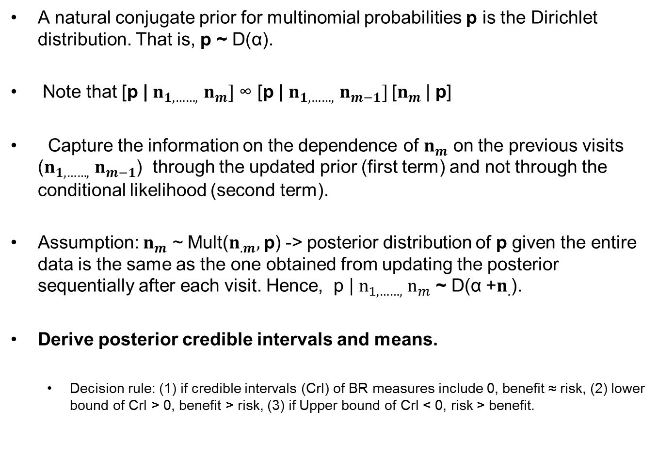
Bayesian Approach to Model Benefit-Risk
A natural conjugate prior for multinomial probabilities p is the Dirichlet distribution. That is, p ~ D(α).
Note that [p | $n_{1, ……,}$ $n_{m}]$ ∞ [p | $n_{1, ……,}$ $n_{m−1}]$[$n_{m}$ | p]
Capture the information on the dependence of $n_{m}$ on the previous visits ($n_{1, ……,}$ $n_{m−1}$) through the updated prior (first term) and not through the conditional likelihood (second term).
Assumption: $n_{m}$ ~ Mult($n_{.m},$p) -> posterior distribution of p given the entire data is the same as the one obtained from updating the posterior sequentially after each visit. Hence, p | $n_{1, ……,}$ $n_{m}$ ~ D(α +$n_{.}$).
Derive posterior credible intervals and means.
  Decision rule: (1) if credible intervals (CrI) of BR measures include 0, benefit ≈ risk, (2) lower bound of CrI > 0, benefit > risk, (3) if Upper bound of CrI < 0, risk > benefit.
12

Slide 13
Bayesian Multi-Criteria Decision Analysis
Waddingham et al. (2015) explore Multi-Criteria Decision Analysis (MCDA) for benefit-risk assessment in a Bayesian framework.
MCDA is a powerful decision-making tool which involves specifying the expected consequences of each alternative course of action, and then establishing the utility associated with each of these consequences.
Preference weights that specify the relative importance of the different outcomes are also required. The optimal decision is that which maximizes (or minimizes) the utility, typically represented by an overall (weighted) BR score.
Since Bayesian statistics formally represents uncertainty by direct probability statements concerning unknown parameters, this makes it a natural fit to express how uncertainties in the input MCDA model parameters affect the uncertainty of the overall BR assessment
13

Slide 14
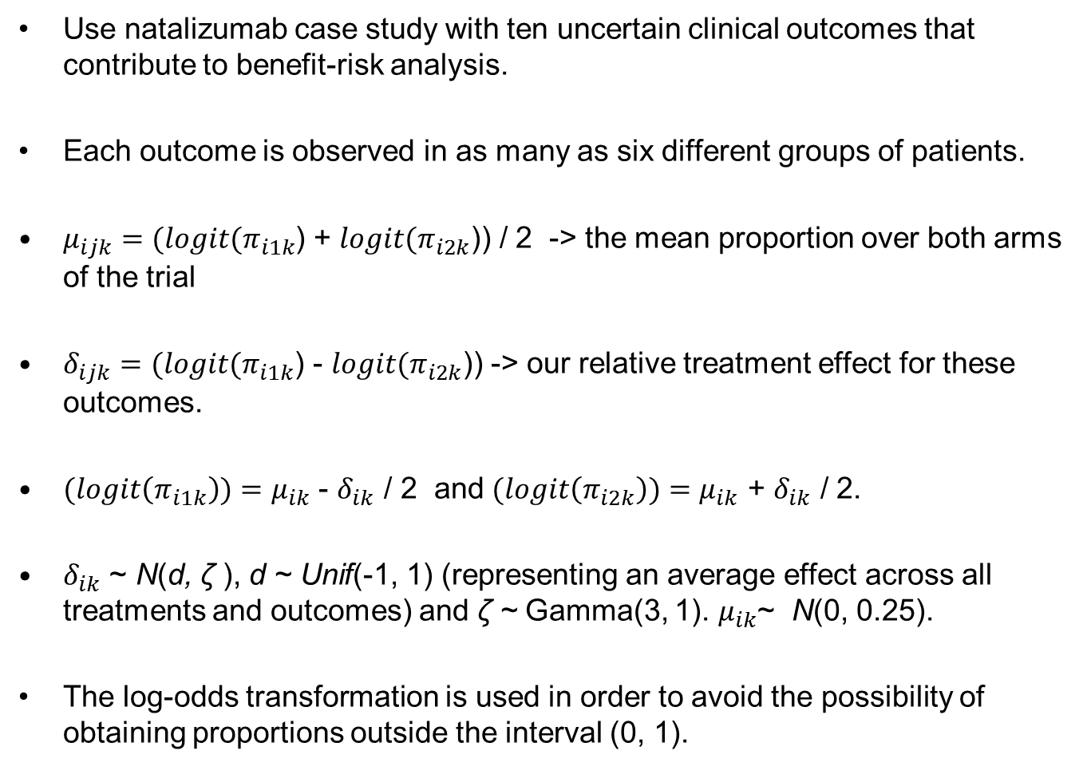
Bayesian Multi-Criteria Decision Analysis (Model Details)
Use natalizumab case study with ten uncertain clinical outcomes that contribute to benefit-risk analysis.
Each outcome is observed in as many as six different groups of patients.
$μ_{ijk}=(logit(π_{i1k}$) + $logit(π_{i2k}$)) / 2 -> the mean proportion over both arms of the trial
$δ_{ijk}=(logit(π_{i1k}$) - $logit(π_{i2k}$)) -> our relative treatment effect for these outcomes.
$(logit\left(π_{i1k}\right))=μ_{ik}$ - $δ_{ik}$ / 2 and $(logit\left(π_{i2k}\right))=μ_{ik}$ + $δ_{ik}$ / 2.
$δ_{ik}$ ~ N(d, ζ ), d ~ Unif(-1, 1) (representing an average effect across all treatments and outcomes) and ζ ~ Gamma(3, 1). $μ_{ik}$~ N(0, 0.25).
The log-odds transformation is used in order to avoid the possibility of obtaining proportions outside the interval (0, 1).
14

Slide 15
Future directions
Accounting for uncertainty: two main sources , model parameter uncertainty, preference/weighting uncertainty.
  A need to understand the impact that different sources of uncertainty have on any benefit-risk (BR) assessment.
  Helps clinical/study teams understand the limits of the evidence generated
  1. Personalised medicine - which patients are more likely to benefit
  2. Strategy - important to understand the impact that uncertainty in the
  data has on the BR profile to minimise attrition. For example, in an
  MCDA analysis, given the chosen weights and utilities, one could ask
  the question: how many events of type X would need to be observed to change the BR conclusions?
15

Slide 16
Future directions
Endpoint selection / Weighting based on empirical data
  - Careful thought should be placed in the selection of endpoints, e.g., endpoint elicitation done before the conduct of the trial.
  - Other option: treat endpoint selection as a model selection problem; that is, use Bayes factors to select the most appropriate endpoints based on all available evidence.
  - Prior distribution for different sets of endpoints / models could be based on both patient clinician preferences.
  - Evidence could consist of data on which endpoints are the most sensitive to changes in efficacy, for example.
16

Slide 17
Future directions
Incorporating external data/expert opinion into BR across the drug development process
  A Key concern: the question of whether certain rare safety findings should be quantified.
  The probabilistic nature of the Bayesian approach can help in such scenarios by representing the rare nature of the event by a probability, conditional on the knowledge that the event is rare.
  Important to understand when new accrue data warrants a change in safety management. Also, take into account patient preference.
  But trying to be non-informative when assessing the probability of a rare event occurring can lead to misleading results; e.g., quantity of interest is not the event rate itself but a function of it.
17

Slide 18
THANK YOU!
I would like to thank all of the team members of the DIA Bayesian Benefit-Risk Working group
Carl Di Casoli (Bayer)
Maria Costa (GSK)
Weili He (Merck, Sharp, and Dohme)
Yannis Jemiai (Cytel)
Yueqin Zhao (FDA/CDER)
Akos Ferenc Pap (Bayer)
Michael Crane
And a special thank you to Karen Price, of Eli Lilly, for organising these groups!
18

Slide 19
References
Levitan, B., Phillips, L.D., and Walker, S. (2014). Structured approaches to benefit-risk assessment: a case study and the patient perspective. DIA Therapeutic Innovation & Regulatory Science, 48: 564-573.
21st Century Cures Act, July 13 2015, URL: https://www.congress.gov/bill/114th-congress/house-bill/6/text [last accessed September 10, 2015].
European Medicines Agency. Benefit-risk methodology project work package 3 report: Field tests. London, European Medicines Agency.
Waddingham E., Mt-Isa S., Nixon R., Ashby D. (2015) A Bayesian approach to probabilistic sensitivity analysis in structured benefit risk assessment. Biom J., 58:28-42.
Braun, T. (2002). The bivariate continual reassessment method: extending the CRM to phase I trials of two competing outcomes. Controlled Clinical Trials, 23:240-256.
19

Slide 20
References
Zhao Y., Zalkikar J., Tiwari R.C., and LaVange L.M. (2014). Bayesian approach for benefit-risk assessment. Statistics in Biopharmaceutical Research, 6:326-337
Chuang-Stein C., Mohberg N.R., Sinkula M.S. (1991). Three measures for simultaneously evaluating benefits and risks using categorical data from clinical trials. Statistics in Medicine, 10:1349-1359.
He W., Cao, X, Xu L. (2012). A framework for joint modeling and joint assessment of efficacy and safety endpoints for probability of success evaluation and optimal dose selection. Statistics in Medicine, 31(5): 401-419.
20

